Slide 1
FASHIONWAVE
₹61.35M
75.10%
Sales Analysis
Total Revenue
Profit Margin
Data Analysis Case Study
15,000
50
Prepared by:
Total Orders
Stores Analyzed
Rishab Bansal
Data Analyst | Business Intelligence
50 Stores • Pan-India Operations
Notes:
Welcome to the FashionWave Sales Analysis Case Study. This presentation covers a full-year retail analysis across 50 stores. Key business objectives: grow weekend sales 15%, improve product profitability, optimize discount strategy.

Slide 2
BUSINESS PROBLEM & OBJECTIVES
02
About FashionWave
Strategic Objectives
FashionWave is a pan-India fashion retail chain operating 50 stores across major metros and Tier-2 cities. With annual revenues crossing ₹61M, the brand sells Clothing, Shoes, and Accessories across new and returning customer segments. Despite strong overall margins, the business faces structural challenges in weekend performance, discount optimization, and product-level profitability.
📈 Grow Weekend Sales
Increase weekend revenue by 15% in the next quarter through targeted campaigns and promotions
Key Business Challenges
💰 Improve Profitability
Weekend sales lag significantly behind weekday performance (28.84% vs 71.16%)
Identify and promote high-margin categories while reducing cost drag in low performers
Inconsistent profitability across product categories
Unclear impact of discount bands on margin health
🏷️ Optimize Discounts
Define data-driven discount thresholds that protect margins while driving conversion
High variance in store-level revenue performance
Success Metrics
+15% Weekend Sales • Margin ≥ 75% • Optimal Discount Band Identified
Notes:
FashionWave has strong overall metrics but faces specific operational gaps. The 71/29 weekday-weekend split suggests significant untapped revenue potential on weekends. Our analysis will uncover root causes and actionable strategies.

Slide 3
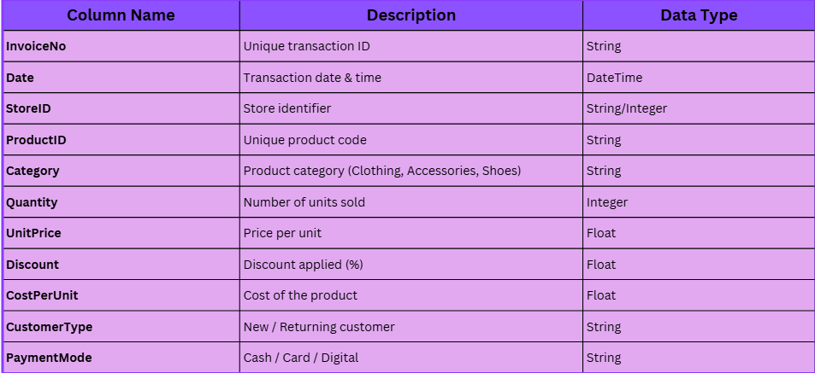
DATASET OVERVIEW
03
Data Fields Used
⚠ Key Assumptions
All transactions are in INR • FY runs Jan–Dec • 50 stores treated equally unless noted
Notes:
The dataset contains transactional records across all 50 FashionWave stores. After cleaning, the dataset is representative and analysis-ready. Day_type and Category are the two most critical segmentation fields for this analysis.

Slide 4
KPI OVERVIEW
04
💹
💰
📊
🛒
₹61.35M
₹46.07M
75.10%
15,000
Total Revenue
Total Profit
Profit Margin
Total Orders
Gross sales across all stores
Net after COGS & discounts
Industry avg: ~55–60%
Avg ₹4,090 per order
Monthly Revenue Trend (Jan–Dec 2025)
Weekday Revenue
₹43.66M (71.16%)
Weekend Revenue
₹17.69M (28.84%)
Target: ₹20.34M (+15%)
Notes:
Our KPIs are strong at the aggregate level. The 75.1% profit margin significantly outperforms the industry average of 55–60%. However, the weekend gap (only 28.84% of total sales) is the biggest untapped growth lever.

Slide 5
PRODUCT CATEGORY ANALYSIS
05
Revenue by Category
Profit by Category
🥇 Accessories Lead
👟 Shoes Strong #2
Accessories is #1 in both revenue (~₹22.5M) and profit (~₹17M), driven by high unit prices and strong repeat demand.
Shoes follows closely with healthy margins. Mid-to-premium footwear lines are strong profit contributors.
👗 Clothing Underperforms
💡 Strategic Insight
Clothing generates lowest revenue and profit despite likely highest SKU count — indicates pricing or mix issues.
Shift marketing budget toward Accessories. Review Clothing pricing and SKU rationalization to improve margins.
Notes:
Accessories shows the highest ROI per SKU. Clothing may have high volume but low margin — needs pricing review. Recommend reallocating promotional spend toward Accessories and Shoes for better returns.

Slide 6
WEEKEND vs WEEKDAY ANALYSIS
06
Unit Price Split by Day Type
Revenue Comparison (₹M)
🎯 Revenue Gap Analysis
Current Weekend Revenue
₹17.69M
Target (+15%)
₹20.34M
Revenue Gap to Close
₹2.65M
Additional Orders Needed
~648 orders / quarter
Footfall Gap:
Weekday footfall benefits from office commuters and lunch shoppers — weekend lacks equivalent footfall drivers.
Pricing Behavior:
Customers tend to defer high-value purchases to weekdays. Weekend baskets may have lower AOV.
Opportunity:
Flash weekend sales, exclusive SKUs, and in-store events can bridge the 2.47x gap vs weekday revenue.
Notes:
Weekend sales represent the single largest untapped revenue pool. Closing even half the gap would add ~₹1.3M quarterly. Focus on experience-based shopping, family bundles, and weekend-only flash promotions.

Slide 7
STORE PERFORMANCE ANALYSIS
08
Top 5 Stores by Revenue
Store Tiers
Tier | Stores | Avg Rev
🏆 Top | 10 | >₹1M
🟡 Mid | 30 | ₹0.8–1M
🔴 Low | 10 | <₹0.8M
🥇 STR037 #1
📍 Location Factor
Top performer at ~₹1.12M revenue. Likely a high-footfall metro location. Study its category mix and staffing model for replication.
Top stores are likely in Tier-1 cities (Delhi, Mumbai, Bengaluru). Geography, footfall density, and mall anchor positions drive performance.
⬇️ Underperforming Stores
🔄 Playbook Replication
Bottom 10 stores show revenue <₹0.8M. Root causes: low footfall, poor local marketing, suboptimal product mix, or small store footprint.
Define a 'winning store playbook' from top performers and apply it to mid-tier stores as quick wins before investing in bottom-tier locations.
Notes:
A 20% revenue gap exists between top and bottom store tiers. Closing half this gap across the bottom 10 stores could add ~₹2M annually. Focus on store manager coaching and localized marketing budgets.

Slide 8
CUSTOMER SEGMENTATION ANALYSIS
09
Order Share by Customer Type
🆕
🔁
New Customers
Returning Customers
70.41%
29.59%
of total orders
of total orders
~10,562 orders
~4,438 orders
Strategy:
Strategy:
Onboarding offers, first-purchase discounts, welcome gift cards to drive second purchase
Loyalty points, early access to new launches, personalized re-engagement campaigns
Engagement Strategy Matrix
New → Active
First-purchase discount + referral bonus to convert to repeat buyer within 60 days
Returning → Loyal
VIP tier upgrade at 5 purchases: free shipping, exclusive launches, birthday rewards
At-Risk Returning
Win-back campaign: 'We miss you' email with 15% off valid for 7 days, personalized product recs
Notes:
70% new customers is impressive acquisition but a warning sign: the retention rate appears low. Increasing returning customer share from 30% to 40% would dramatically improve LTV and reduce CAC. Focus on post-purchase engagement.

Slide 9
KEY INSIGHTS & HIDDEN TRENDS
10
📉 RISK
🎯 OPPORTUNITY
📅 TREND
Revenue Concentration Risk
Accessories Margin Premium
Seasonal Revenue Dips
Top 10 stores (20%) generate an estimated 35%+ of total revenue. Over-reliance on a few outlets creates fragility — any disruption hits disproportionately.
Accessories yields the highest revenue AND profit, yet likely receives lower floor space vs Clothing. Reallocating display area could yield +5–8% overall margin uplift.
Revenue shows a gradual decline Aug–Nov (from ₹5.2M to ₹4.8M) before a year-end recovery. Pre-emptive October campaigns can prevent this seasonal drag.
🔄 RISK
💸 OPPORTUNITY
🏪 TREND
Retention Rate Alert
Discount Band Arbitrage
Store Performance Disparity
With 70.41% new customer share, the implied repeat purchase rate is ~29%. Industry leaders maintain 40–50%. Low retention inflates CAC and suppresses LTV.
10 percentage-point margin gap between 0–10% and 21–30% discount bands. Standardizing to low-band discounts across all stores could add ~₹3M to annual profit.
20%+ revenue gap between top and bottom store tiers suggests systemic differences in execution, staffing, and local marketing — not just geography.
Notes:
These six insights form the core analytical payload of the project. Each maps directly to an actionable recommendation. Present these as 'the 6 things we'd do first if given authority today.'

Slide 10
RECOMMENDATIONS
11
⚡ QUICK WINS (0–3 Months)
🚀 LONG-TERM STRATEGIES (3–12 Months)
01
Weekend Flash Sales
04
Loyalty Program Launch
+₹1.2M/quarter
+LTV 40%
Launch Friday evening to Sunday campaigns with 5–8% exclusive discounts. Target commuter-free weekend mindset with 'Weekend Specials' branding.
Introduce tiered loyalty: Bronze → Silver → Gold. Reward at 3, 5, 10 purchases with escalating perks. Target: raise returning customer % from 30% to 45%.
02
Accessories Push
05
Predictive Demand Forecast
+₹0.8M/quarter
–8% COGS
Increase floor display share and digital ad budget for Accessories by 20%. Train staff on upselling Accessories with every Clothing/Shoes transaction.
Deploy ML-based demand forecasting per store + category. Reduce overstock in low-performing stores and prevent stockouts in top stores.
03
Discount Band Policy
06
Store-Specific Pricing
+₹0.5M margin
+₹3M margin
Mandate maximum 10% standard discount. Require manager approval for >15%. Implement discount tracking dashboard for store managers.
Introduce geo-based price bands: premium pricing in Tier-1 cities, competitive pricing in Tier-2. Build category-level margin guardrails per store type.
💰 Projected 12-Month Business Impact
Increase Weekend Sales
Margin Uplift
Increase Retention Target
Decrease Inventory Cost
Notes:
The 6 recommendations are prioritized by implementation speed. Quick wins in Q1 generate momentum and ROI. Long-term strategies compound the gains. Expected total impact: ₹5–8M incremental profit over 12 months.

Slide 11
CONCLUSION
Expected Business Impact
FashionWave Sales Analysis
Weekend Revenue Target
₹20.34M (+15%)
Key Takeaways
FashionWave is fundamentally healthy with a 75.1% profit margin — well above industry norms
Annual Profit Uplift
₹5–8M additional
The weekend revenue gap (28.84% vs 71.16%) is the single largest quick-win opportunity
Customer Retention Goal
Accessories is the star category — underinvested relative to its return potential
30% → 45% returning
Discounts above 10% erode margins by up to 10 percentage points with limited volume offset
Inventory Cost Reduction
Customer retention at ~30% is below benchmark — loyalty infrastructure is urgently needed
–8% via forecasting
Prepared by Rishabh Bansal
"Data is not just about the past — it's the
blueprint for a better future."
Data Analyst | June 2026
Notes:
Closing slide. Summarize: FashionWave has strong fundamentals. The three-pronged strategy — weekend growth, category focus, discount discipline — can deliver ₹5–8M incremental profit in 12 months with no additional capital expenditure.

